Slide 1
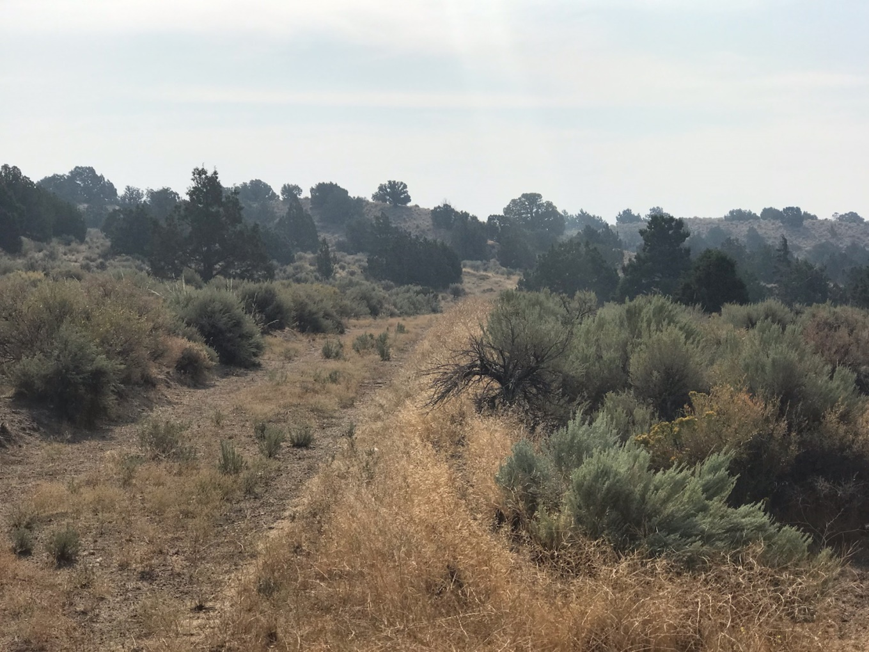
WSUP19-0014 Columbia Hill Grading
Washoe County Board of Adjustment
October 3, 2019

Slide 2
Request
The application is requesting a special use permit (SUP) for major grading of an area of approximately 130,921 sq. ft. with 4,031 cubic yards of cuts and 4,147 cubic yards of fill.

Slide 3
Major Grading Thresholds
WCC 110.438.35(2)(i)(C) Grading of more than two acres on slopes in excess of 15% and;
WCC 110.438.35 (3) Any driveway or road that traverses any slope of thirty (30) percent or greater (steeper).

Slide 4
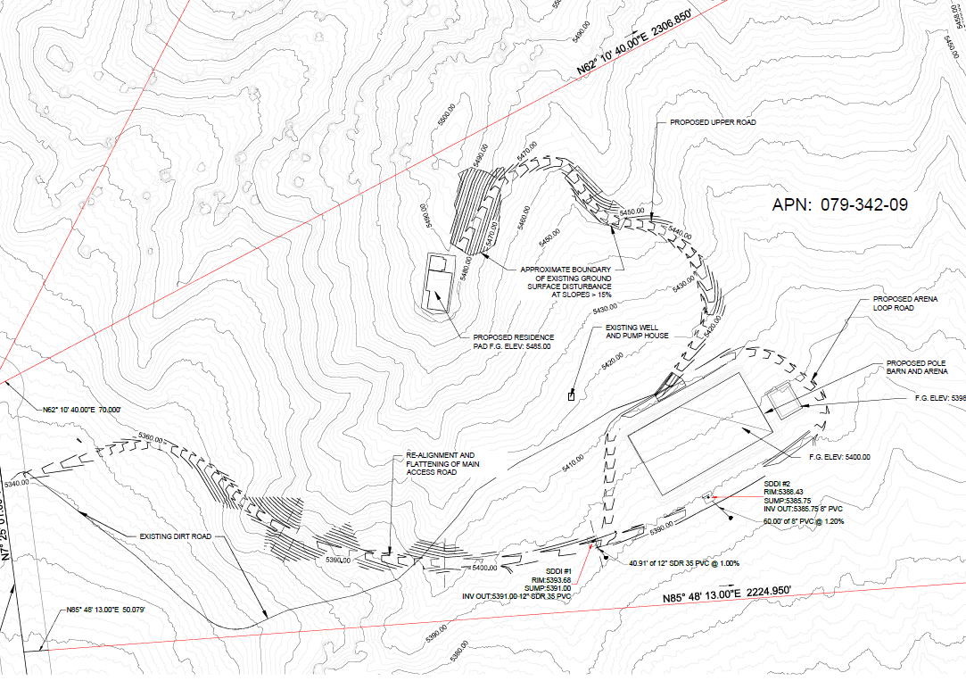

Slide 5
Background
The site does have a previously graded driveway on the property
Much of the proposed grading is not visible from surrounding properties

Slide 6
Public Notice & CAB
Public notice was sent to 41 parcels
The North Valleys CAB reviewed the application on September 9, 2019 and recommended to approve the project.

Slide 7
Special Us Permit Findings
1. Consistency;
2. Improvements;
3. Site Suitability; and
4. Issuance Not Detrimental
Staff is able to make all the required findings, as detailed in the staff report on Page 8

Slide 8
Possible Motion
I move that, after giving reasoned consideration to the information contained in the staff report and information received during the public hearing, the Washoe County Board of Adjustment approve with conditions Special Use Permit Case Number WSUP19-0014 for Teru Langsdale, having made all four findings in accordance with Washoe County Code Section 110.810.30

